Slide 1
NLP for RE
Introduction of RE and NLP
Dr. Gouri Deshpande, Dr. Mariana Bento*, and Mitra Mirshafiee (Graduate Student)
Electrical and Software Engineering; *Biomedical Engineering

Slide 2
Tutorial outline
A. Introduction of RE and NLP (not interactive) (25 mins)
B. Data gathering (interactive)(1hr)
C. Pre-processing using NLP operations for a dataset from Bugzilla (interactive) (1hr)
D. Modeling and evaluation (interactive) (30 mins)

Slide 3



Intros
Mariana Bento
Assistant Professor,​
University of Calgary​ mariana.pinheirobent@ucalgary.ca​
Website: https://profiles.ucalgary.ca/mariana-bento
LinkedIn: https://www.linkedin.com/in/mariana-bento-b7a75010b/
Gouri Deshpande
Assistant Professor,
University of Calgary Gouri.deshpande@ucalgary.ca
Website: https://pages.cpsc.ucalgary.ca/~gouri.deshpande/
LinkedIn: https://www.linkedin.com/in/deshpandegouri/
Mitra Mirshafiee
Master of CS Student,​
University of Calgary​ Mitrasadat.mirshafie@ucalgary.ca​
Website: https://mitramirshafiee.ir/
LinkedIn: https://www.linkedin.com/in/mitra-mirshafiee-data-scientist/

Slide 4
Learning Goals
Introduction to RE
Introduction to NLP
Notes:
RE public repositories for data mining

Slide 5
Introduction of RE

Slide 6
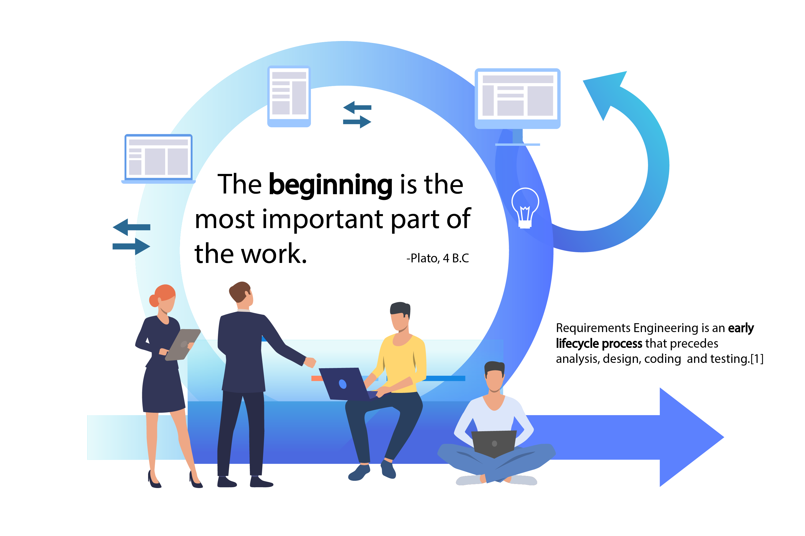
[1] Bencomo, Nelly, Jin LC Guo, Rachel Harrison, Hans-Martin Heyn, and Tim Menzies. "The Secret to Better AI and Better Software (Is Requirements Engineering)." IEEE Software 39, no. 1 (2021): 105-110.

Slide 7
Brief Introduction to Software Development Process
Inception
Knowledge Elicitation
Requirements Analysis
A simplified Linear model of software development process:
Design
Implementation
Testing

Slide 8



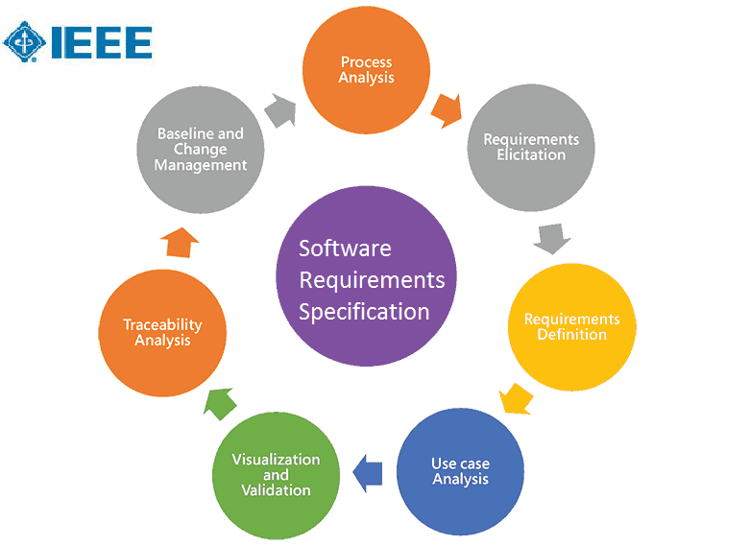
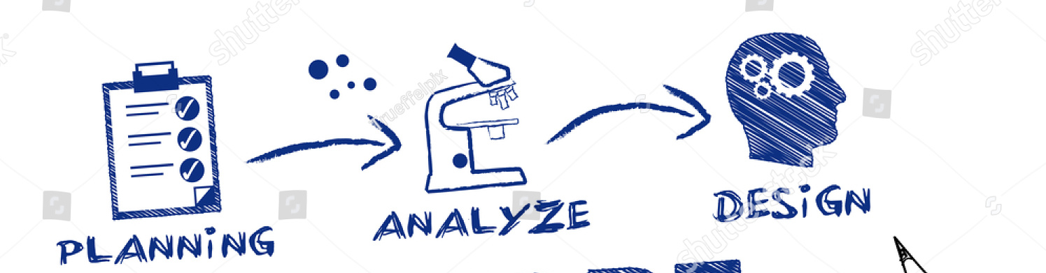
Software requirements Specification
Introduction: For Software product and defined by the customer
Overall Description: Functions, Users, Constraints, etc.
Overall Description: Functional, non-functional, interfaces, etc.

Slide 9



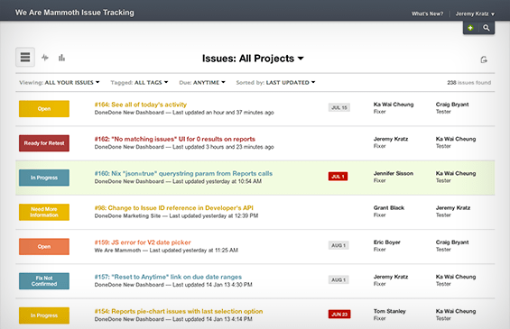





Requirements Elicitation Techniques
Brain Storming
Document Analysis
Focus Group
Interface Analysis
Interviews
Observation
Process Modeling
Prototype
Workshops
Surveys/Questionnaire
https://systemsplusgroup.blogspot.com/2017/02/requirement-elicitation-techniques.html
Notes:
Requirements elicitation is an excellent example of how things can improve with additional data, in this case in particular with textual data.

Slide 10
Introduction to NLP

Slide 11




NLP and Machine learning
Count TFIDF
Hashing Vectorizer
On all documents
Huge Matrix with Numbers
ML/DL Model
Classification
Language Generation
Part of Speech Tagging
Question Answering
Etc.
Source: https://www.datajango.com/deep-learning-and-nlp/

Slide 12
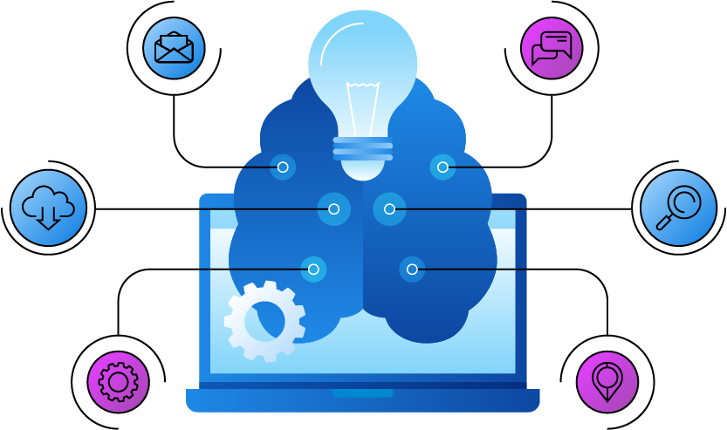
Natural Language Processing (NLP)
Classifying Emails
Sentiment Analysis
Translation Applications
Fake News Application
Medical condition prediction
Personal Voice Analysis
NLP is a subfield of artificial intelligence that deals with the link between computers and human language. NLP involves programming computers to process and analyze a massive amount of natural language data.

Slide 13

What are Some Applications of NLP in the Industry?
Search engines
Advanced text editors: Such as Grammarly.com
Computational advertising
Fraud detection
Sentiment analysis
Opinion mining
Text summarization
Context analysis

Slide 14
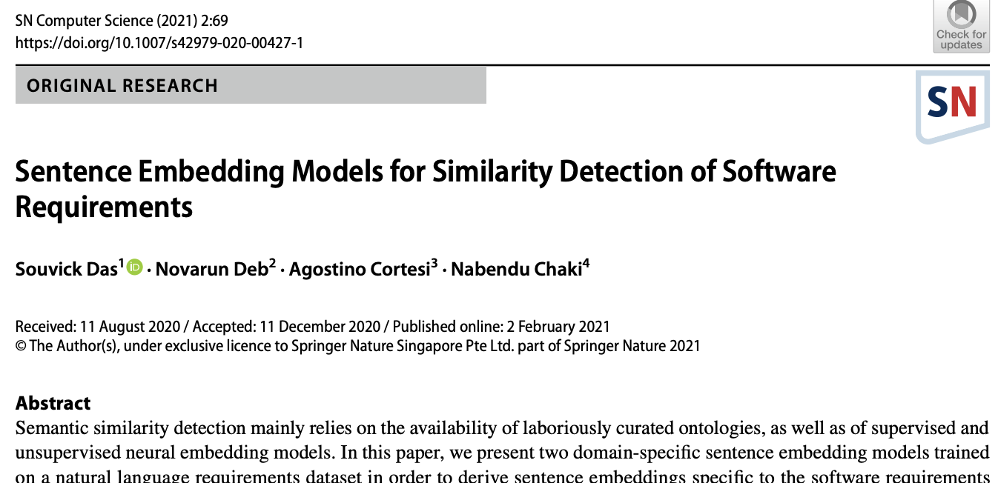
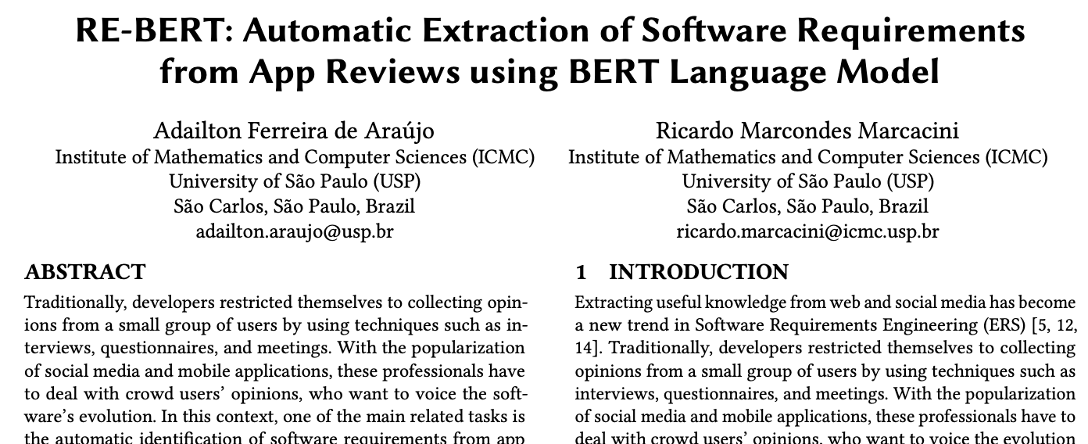
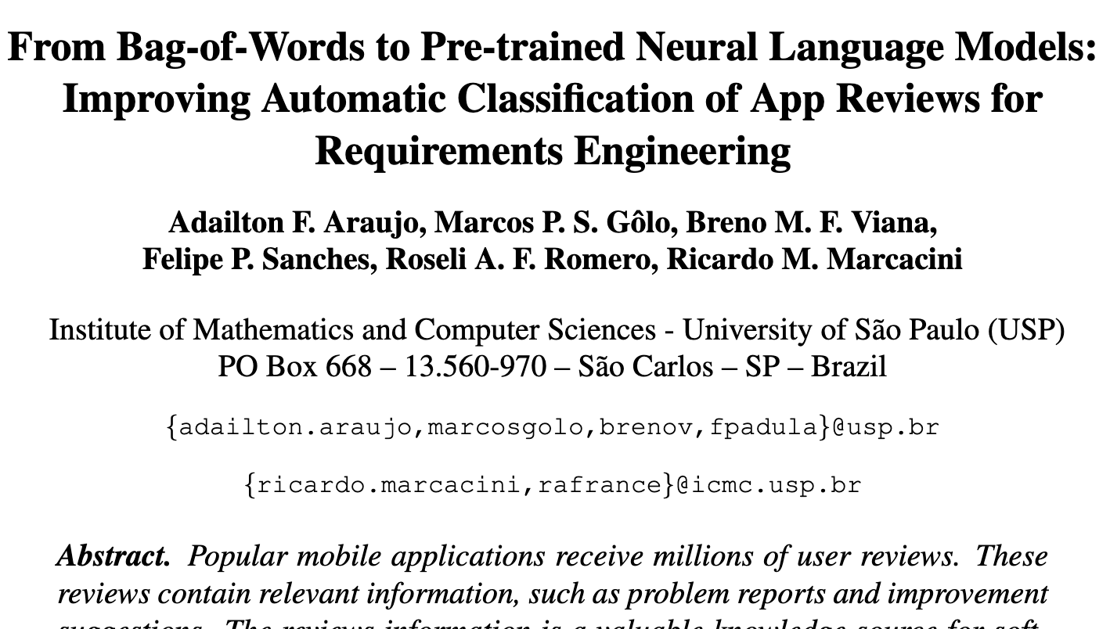
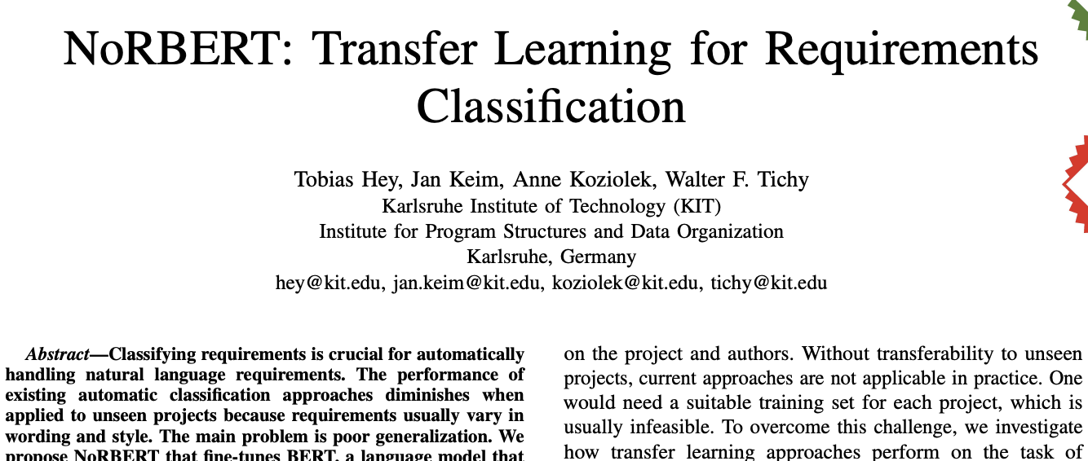
Example Papers
Applications of NLP in RE

Slide 15
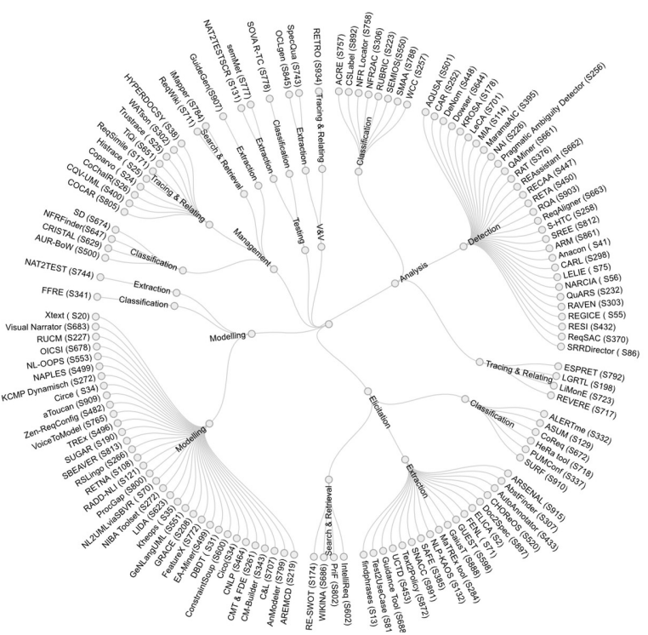
NLP for RE Tools
Zhao, Liping, et al. "Natural language processing (NLP) for requirements engineering: A systematic mapping study." arXiv preprint arXiv:2004.01099 (2020).

Slide 16
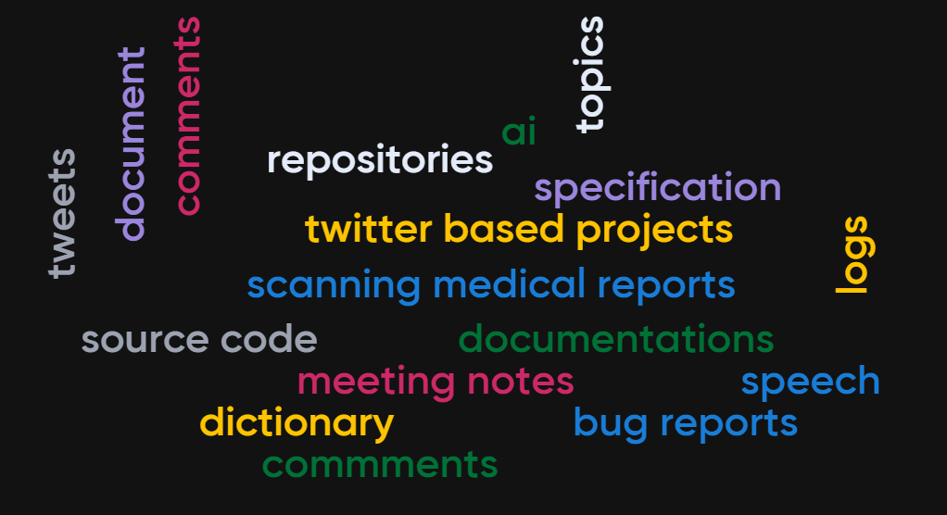
Software Projects are Textual in Nature

Slide 17
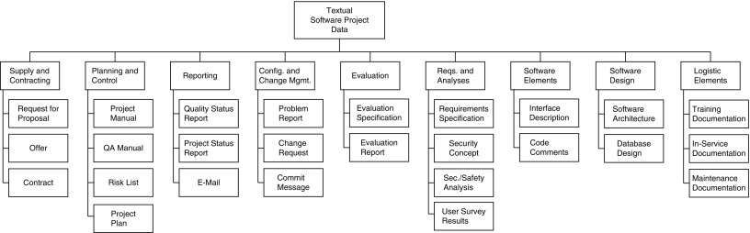
Textual Data in Software Projects
Customer review comments
Bird, Christian, Tim Menzies, and Thomas Zimmermann, eds. The art and science of analyzing software data. Elsevier, 2015.
17

Slide 18
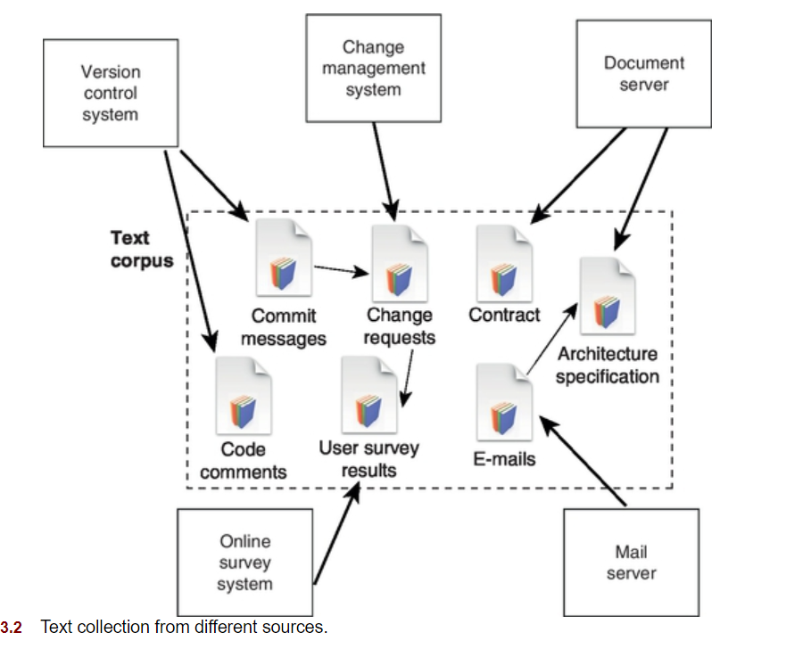





Textual Software Project Data and Retrieval
Custom extraction tool
API’s
Formatted files
Anonymize
Web crawling
Arnaoudova, Venera, et al. "The use of text retrieval and natural language processing in software engineering." Proceedings of the 37th International Conference on Software Engineering-Volume 2. 2015.

Slide 19
Importance of NLP in Software Engineering
Text Retrieval (TR) and NLP in software is one of the fastest growing areas of research in SE. [2]
Exposing the SE community to these techniques and their applications in SE would help to fill a gap in their current background and allow them to immediately use TR and NLP to advance their research.
In particular, for TR, approaches such as Vector Space Model, Latent Semantic Analysis, Latent Dirichlet Association, Language Models will be covered. NLP techniques covered will include part-of-speech tagging, stemming, stopwords elimination, semantics analysis, sentiment analysis, etc.

Slide 20
References
Bird, Christian, Tim Menzies, and Thomas Zimmermann, eds. The art and science of analyzing software data. Elsevier, 2015.
Arnaoudova, Venera, et al. "The use of text retrieval and natural language processing in software engineering." Proceedings of the 37th International Conference on Software Engineering-Volume 2. 2015.
Juergens, Elmar, et al. "Do code clones matter?." 2009 IEEE 31st International Conference on Software Engineering. IEEE, 2009.
Juergens, Elmar, et al. "Can clone detection support quality assessments of requirements specifications?." Proceedings of the 32nd ACM/IEEE International Conference on Software Engineering-Volume 2. ACM, 2010.
https://medium.com/square-corner-blog/topic-modeling-optimizing-for-human-interpretability-48a81f6ce0ed
Reference to a few pictures designed by : vectorjuice / Freepik, pch.vector / Freepik, Omnibus-Type / Freepik, katemangostar / Freepik

Slide 21
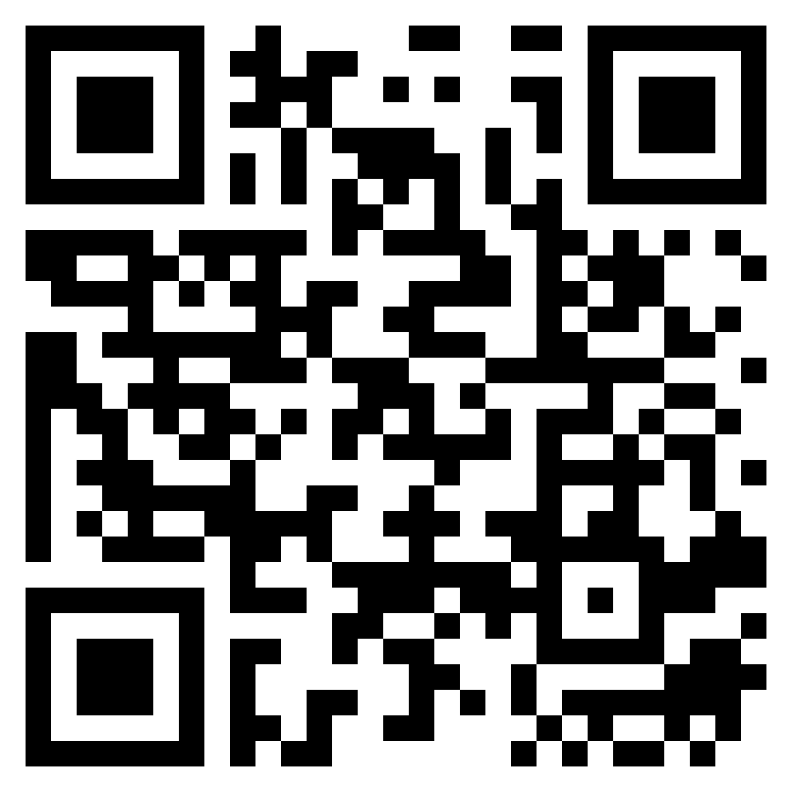
SURVEY
https://forms.gle/TuVVuAkf4JWHFDp17

